Slide 1



FASED: FPGA-Accelerated
Simulation and Evaluation of DRAM
David Biancolin, Sagar Karandikar, Donggyu Kim, Jack Koenig, Andrew Waterman, Jonathan Bachrach, Krste Asanović

Slide 2
Part 1: On Using FPGAs to Simulate ASICs
An introduction to FireSim, FASED’s simulation environment

Slide 3
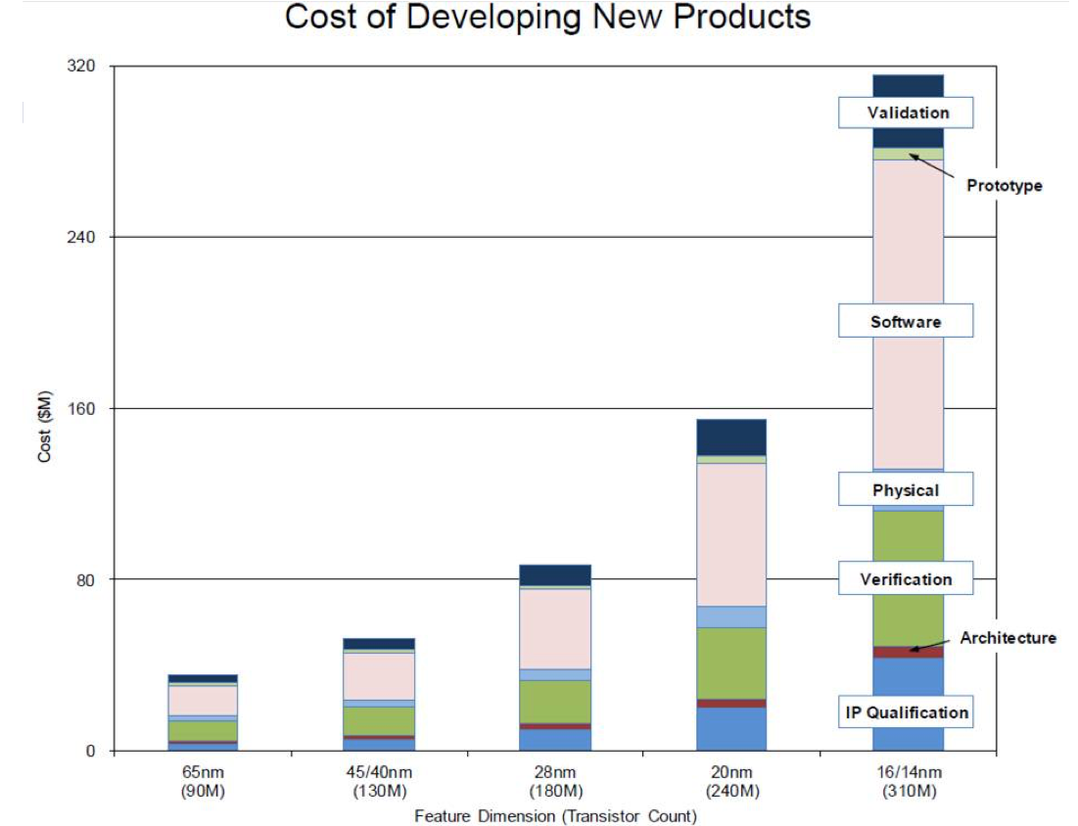
Moore’s Law ($) Has Ended but the NRE Remains
Our group wants to make building custom silicon more accessible:
Chisel & FIRRTL to make HW design more productive
RISC-V to make it easier to architect much of the SoC
How about validation, verification and software?
Source: IBS

Slide 4
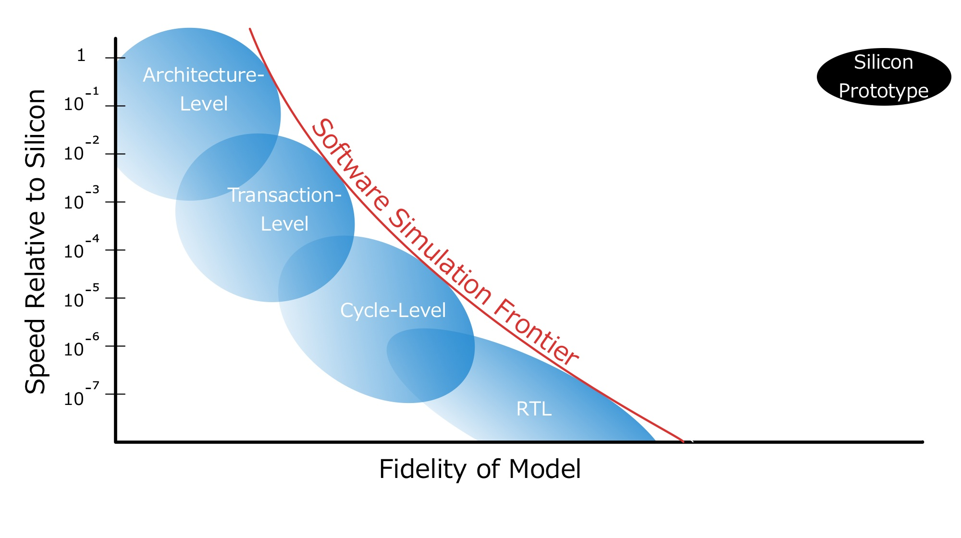
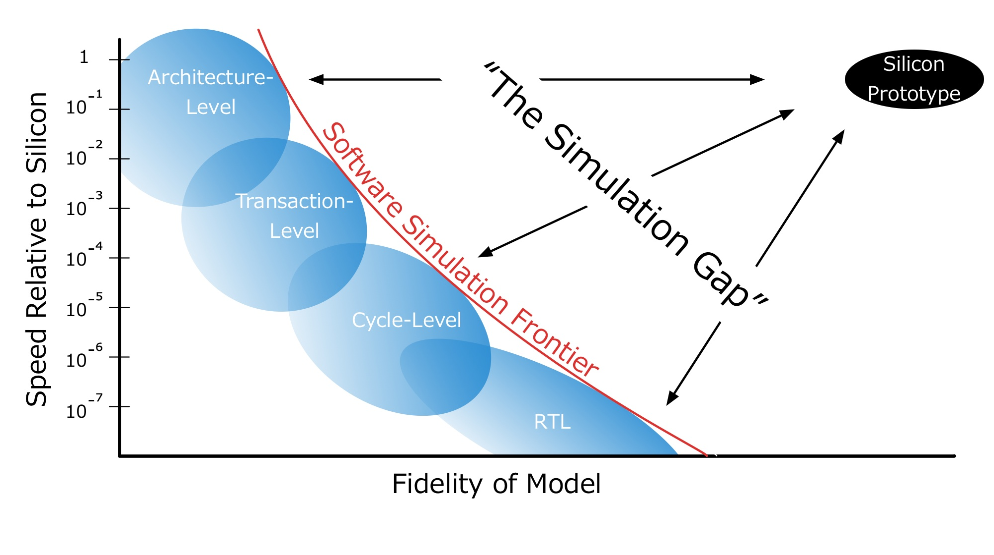
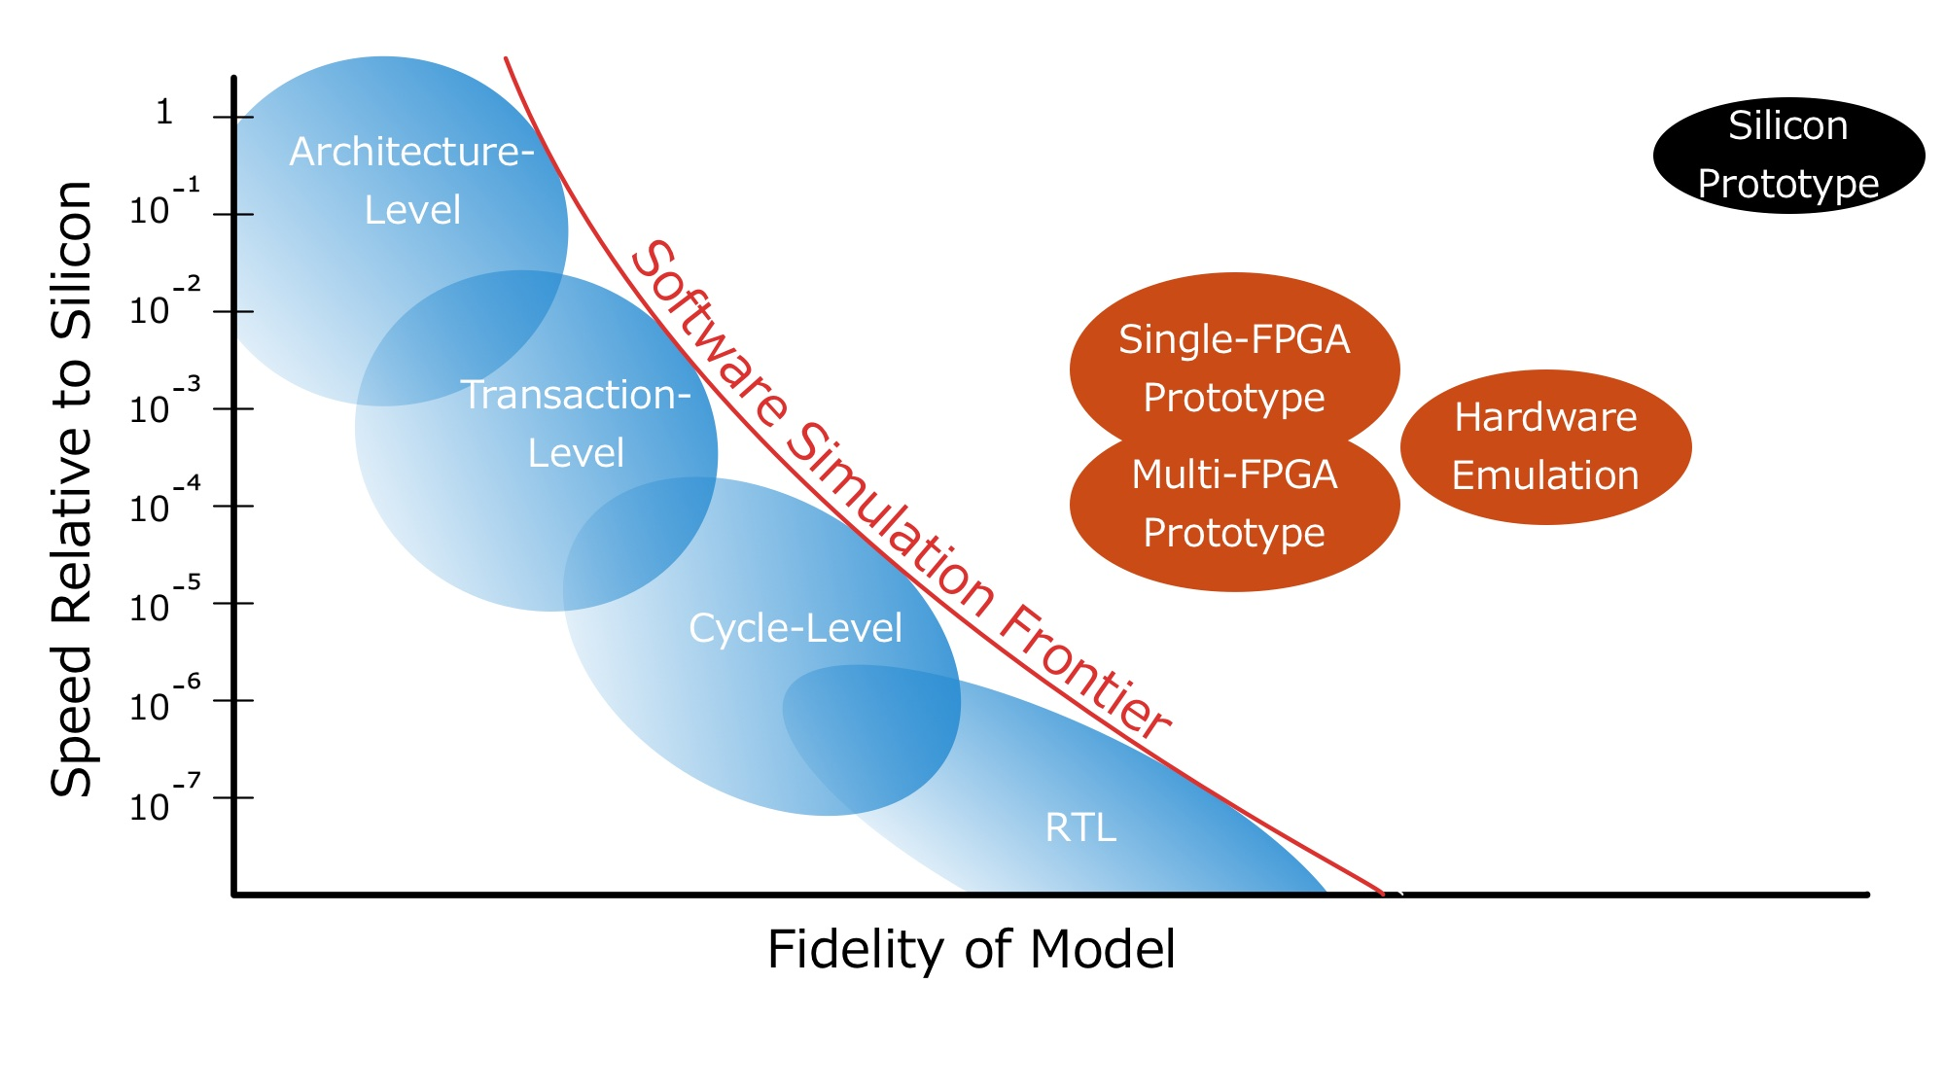

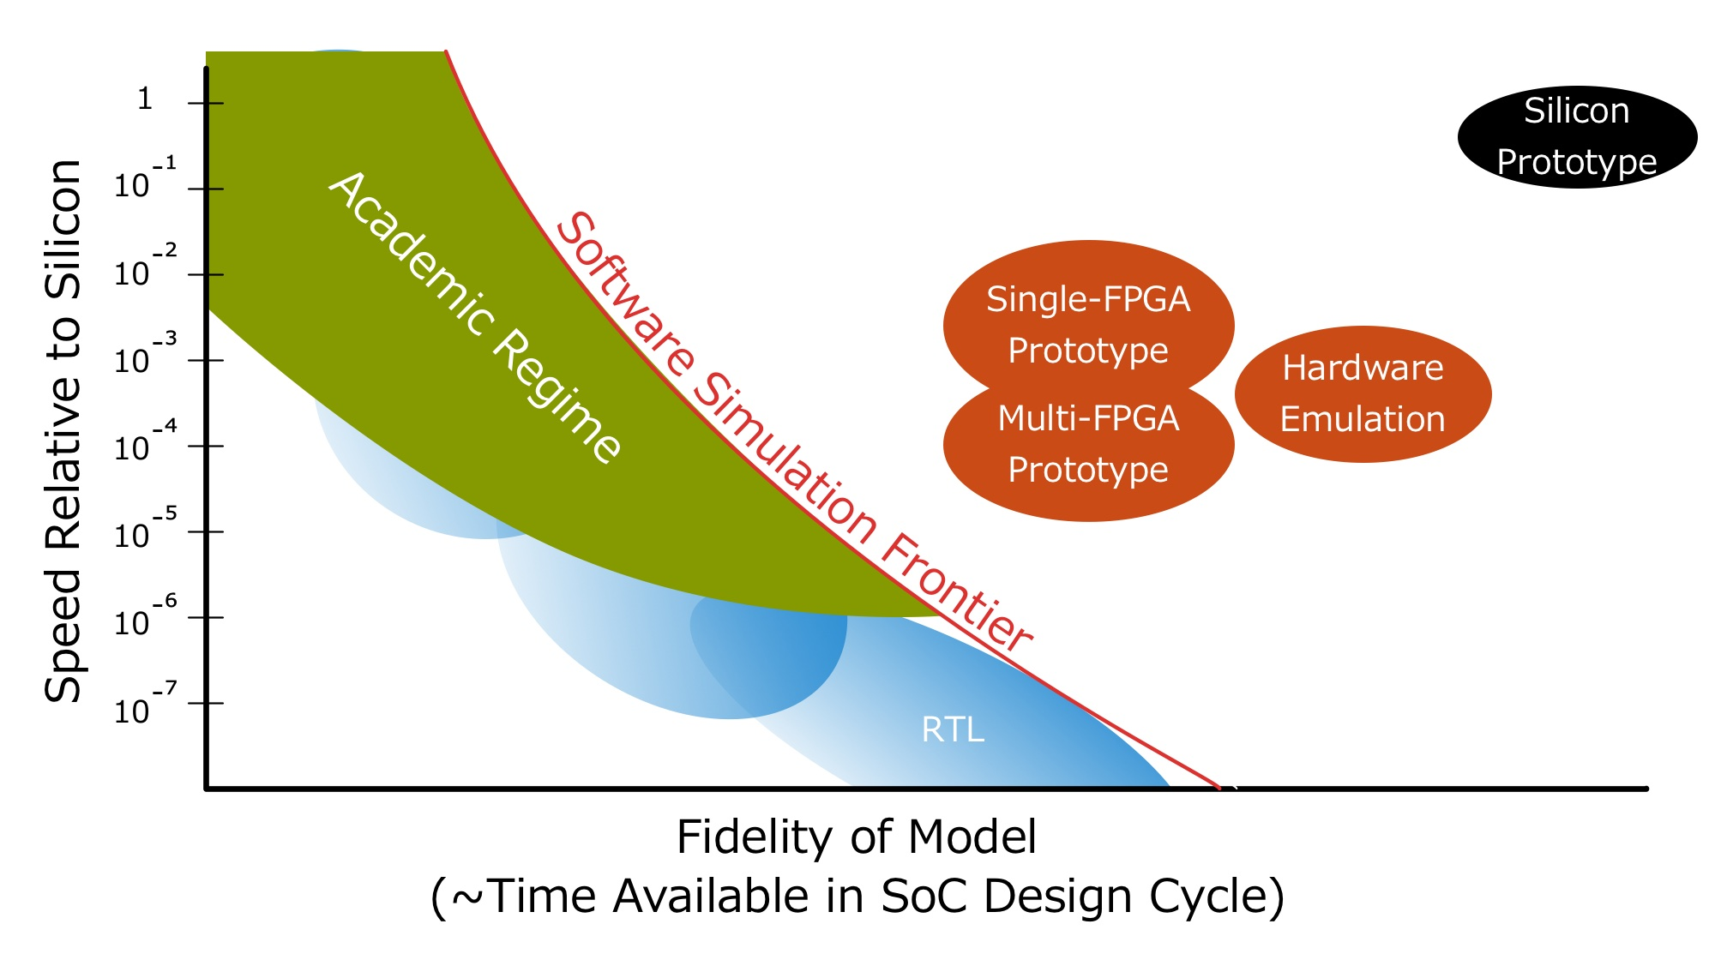
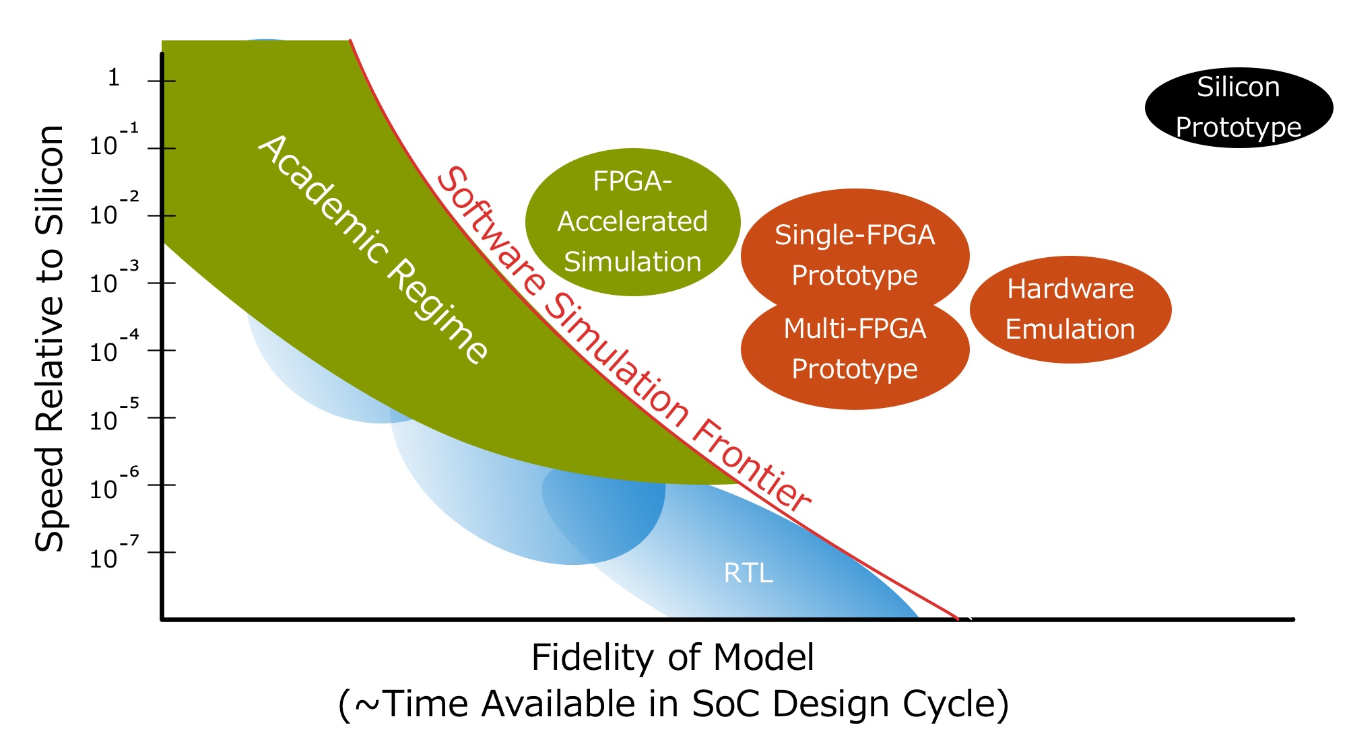


Slide 5
FPGA-Accelerated Simulation
vs.
FPGA Prototyping
We’re not just synthesizing a design into LUTs.

Slide 6
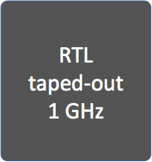

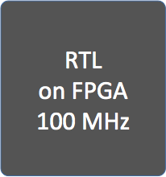

Some Limitations of Conventional FPGA Prototypes
Non-determinism & I/O modeling challenges: I/O, DRAM timing models dependent on variable, host-FPGA DRAM & I/O timing
100 cycles
10 cycles!
Resource limited: Need multiple FPGAs to prototype non-trivial systems
Usability: Difficult to build, modify, debug
Notes:
Show number of cycles to clarify timing mismatch

Slide 7
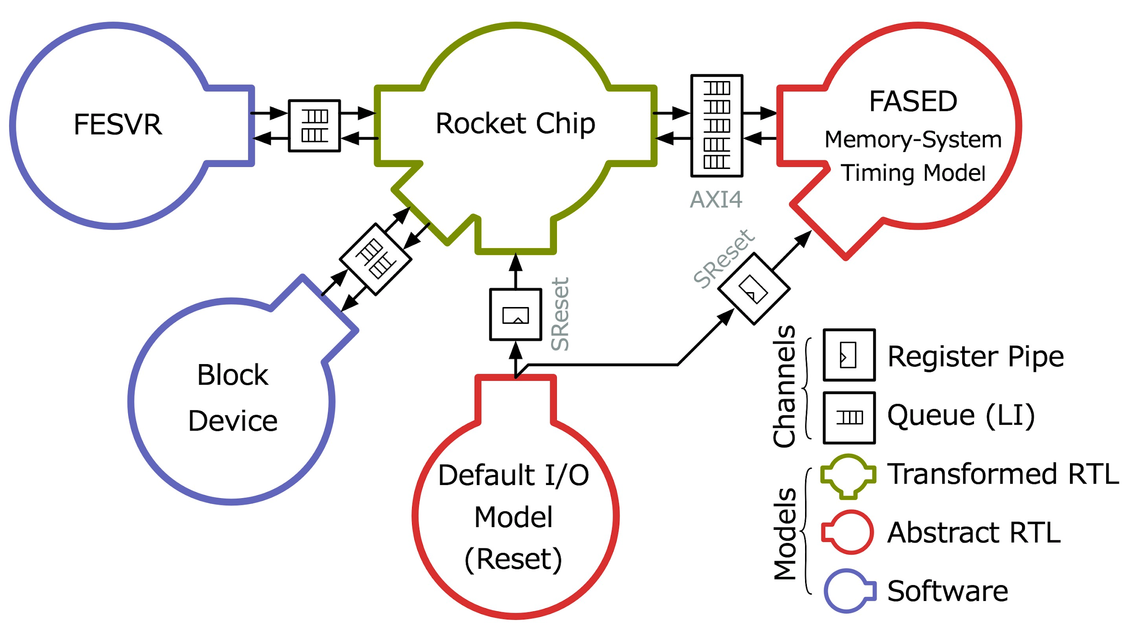
Discrete-Event Simulation using FPGAs (RAMP)
Separate target from host
Represent target as a dataflow graph. Closed system.
3 constituents:
  Models
  Channels
  Tokens
Decoupled RTL models can be abstract, highly optimized for FPGA

Slide 8
How Is FireSim Different from RAMP?
1. Don’t hand-write abstract FPGA-hosted models.
Generate bit-exact models from RTL that would be taped out
Write target-RTL as generators (in Chisel)
Apply host-decoupling as compiler transformation
2. Don’t build custom FPGA host-platforms, use someone else’s!
Technology Changes:
Availability of open IP: Rocket-Chip, BOOM, etc...
FPGAs in the cloud (AWS F1, Catapult)
Continued FPGA capacity scaling
Notes:
Table: RAMP vs. MIDAS
MIDAS is the core technology to simulate RTL in FireSim

Slide 9
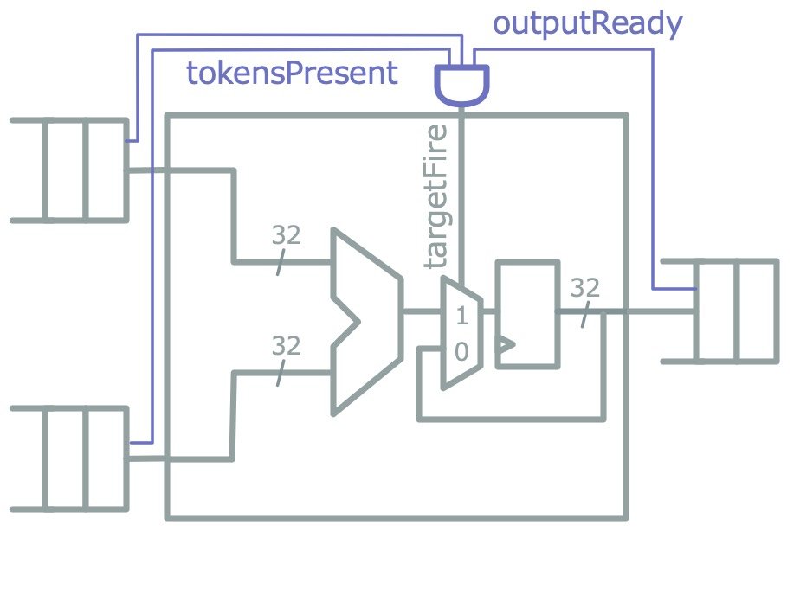
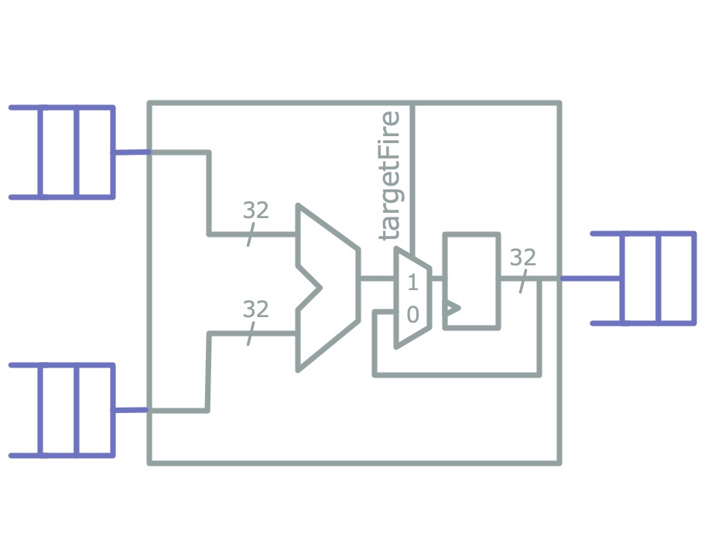
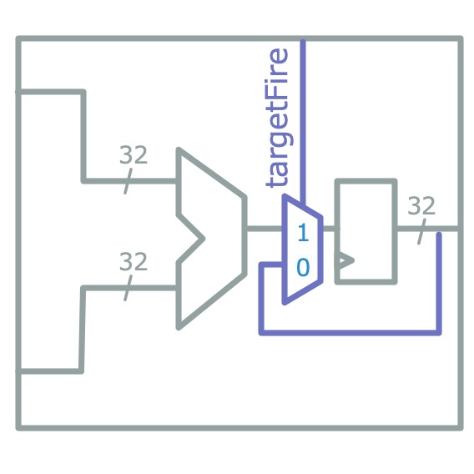
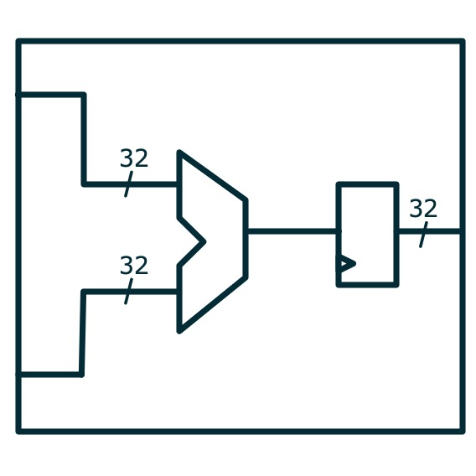
Host-Decoupling (FAME1) Transform on FIRRTL
Luca Carloni et. al, Theory of Latency Insensitive Design

Slide 10
Part 2: FASED – Modeling Memory Systems in FireSim

Slide 11
Outer-Memory Systems are Difficult to Model
Can’t model in fabric; too much state
Can’t model in software; too low latency (10s of ns)
→ Need an FPGA-hosted model that reuses host-FPGA DRAM
How about transforming source-RTL?
Difficult to spoof different memory standards at the PHY boundary
Relatively small CAS latency
How about large last-level caches?
→ Model timing at controller interface (AXI4)
Notes:
1m

Slide 13
Anatomy of a FASED Instance
Split timing and functional model¹
Timing-models written as target-time RTL
Functional model appears as single-cycle CAM
Reuse FAME transform to apply host-decoupling
Configuration port bound to memory-mapped registers for runtime reconfiguration
¹Joel Emer et al, ASIM: A Performance Model Framework

Slide 14
Example Execution:
Single-Cycle Memory System
Cycle Counts
Target: 0
Host: 0
V
V
Legend
V
Token w/ Transaction
Token w/o Transaction
H
Host Transaction

Slide 15
Example Execution:
Single-Cycle Memory System
Cycle Counts
Target: 1
Host: 1
H
Cycle Counts
Target: 1*
Host: 1 → 2
V
STALL
Legend
V
Token w/ Transaction
V
Token w/o Transaction
Miss!
H
Host Transaction

Slide 16
Example Execution:
Single-Cycle Memory System
Cycle Counts
Target: 1
Host: 42
Cycle Counts
Target: 1*
Host: 42 → 43
STALL
Legend
V
Token w/ Transaction
V
Token w/o Transaction
Miss!
H
H
Host Transaction

Slide 17
Example Execution:
Single-Cycle Memory System
Cycle Counts
Target: 1 → 2
Host: 43 → 44
Cycle Counts
Target: 1
Host: 43
Legend
V
Token w/ Transaction
V
Token w/o Transaction
H
Hit!
V
H
Host Transaction

Slide 18
Target Latency > Host Latency
→ Few or No Stalls
Good simulation performance modeling DRAM.
Notes:
10s

Slide 19
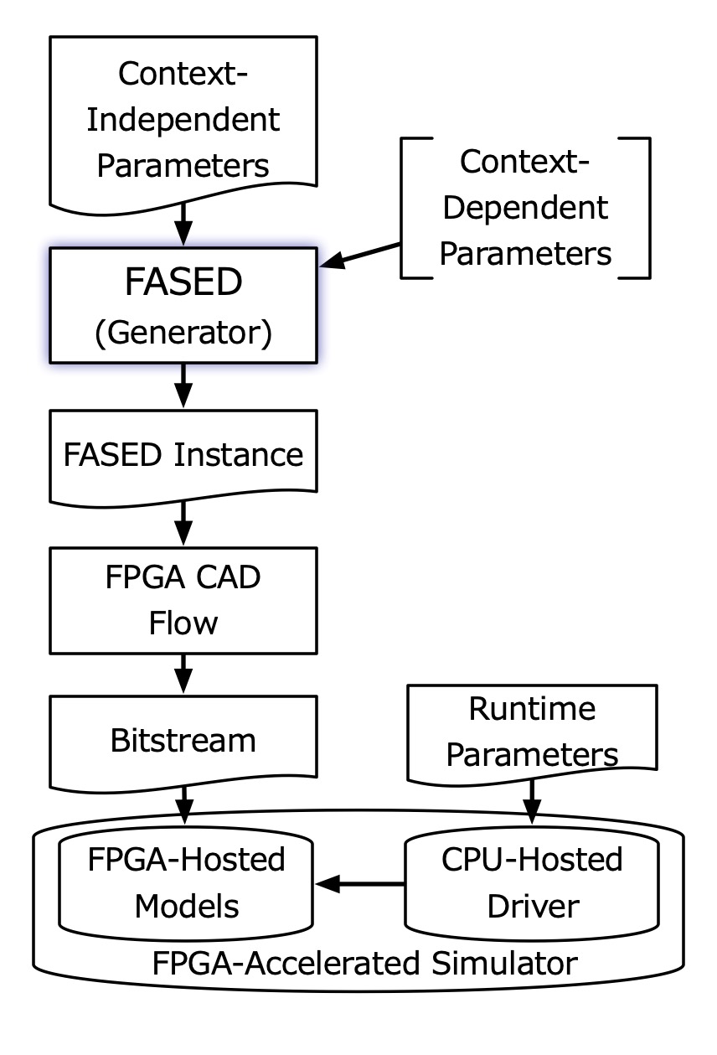
Two-Phase Configuration
A model is configured over two phases:
At generation time, a particular hardware instance is generated
An instance can model a space of different memory systems.
At runtime, the instance is programmed with final timing parameters
A point in that space is picked at runtime.

Slide 20
Timing Models
Notes:
10s

Slide 21
DDR3 Timing Models
FASED has two types of DRAM timing models:
First come, first served (FCFS)
First-ready FCFS¹
Shared run-time configuration parameters:
memory organization
address assignment
page policy
DRAM timings
Model fidelity comparable to DRAMSim2 (just missing power down modes)
¹Scott Rixner et al. Memory Access Scheduling
Notes:
1m

Slide 22
Composable Last-Level Cache Model
DRAM-side, writeback cache
models only tags, not data
runtime configurable settings:
  block size
  # sets, ways
  # of MSHRs
Composable with any DRAM timing model
writeback and refill traffic accurately modeled

Slide 23
Validation
For LLC and generic timing models:
Wrote golden models
Used synthetic stimulus generators
Ran core-side validation tests¹
For DDR3 models:
In RTL simulation, emit DRAM command trace
Pass DRAM command trace to Micron DDR3 model
Same approach used by all academic SW cycle-accurate DRAM simulators.
¹CCBench, https://github.com/ucb-bar/ccbench
Notes:
1m

Slide 24
Adding New Timing Models
Easy to add a new timing model. Need:
Target-side: AXI-4 port & reset
Functional model request-response port
Configuration & instrumentation port
How?
Can write Chisel; extend an existing class
Can write Verilog or use HLS
  We’ll insert a clock-gating element in front
Use an existing DRAM controller
  With some modification to speak to functional model

Slide 25
Other Compelling Features
Notes:
10s

Slide 26
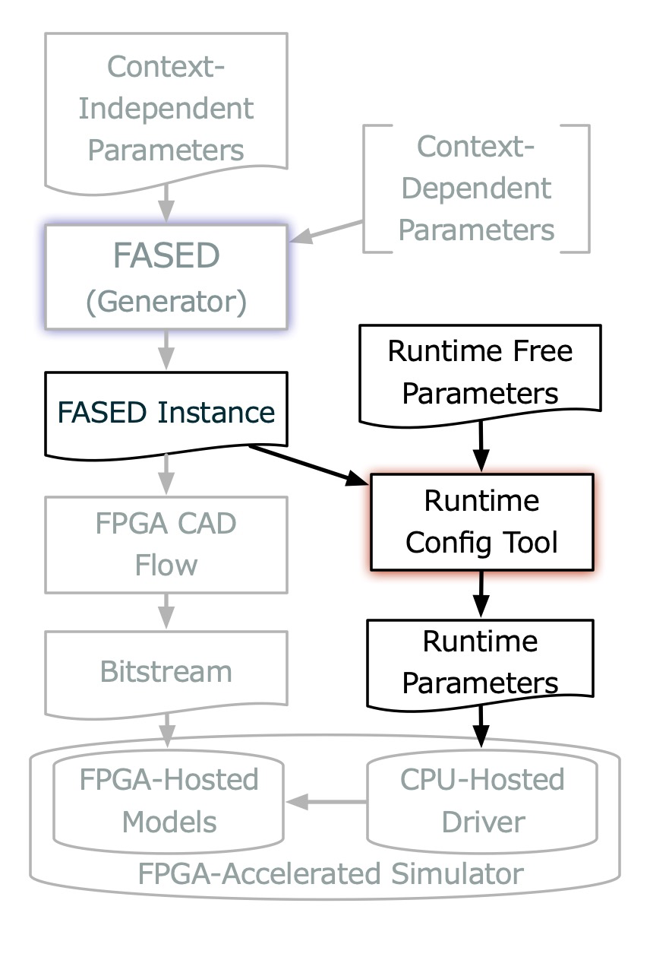
Legalizing Runtime Configurations
Timing model runtime parameters are low-level, easy to mess up
DDR3-2133
Quad rank
Stripe cachelines
Don’t want to provide many configs
Don’t want to look up datasheets
tCAS = 14
tRFC = 260
tFAW = 25

Slide 27
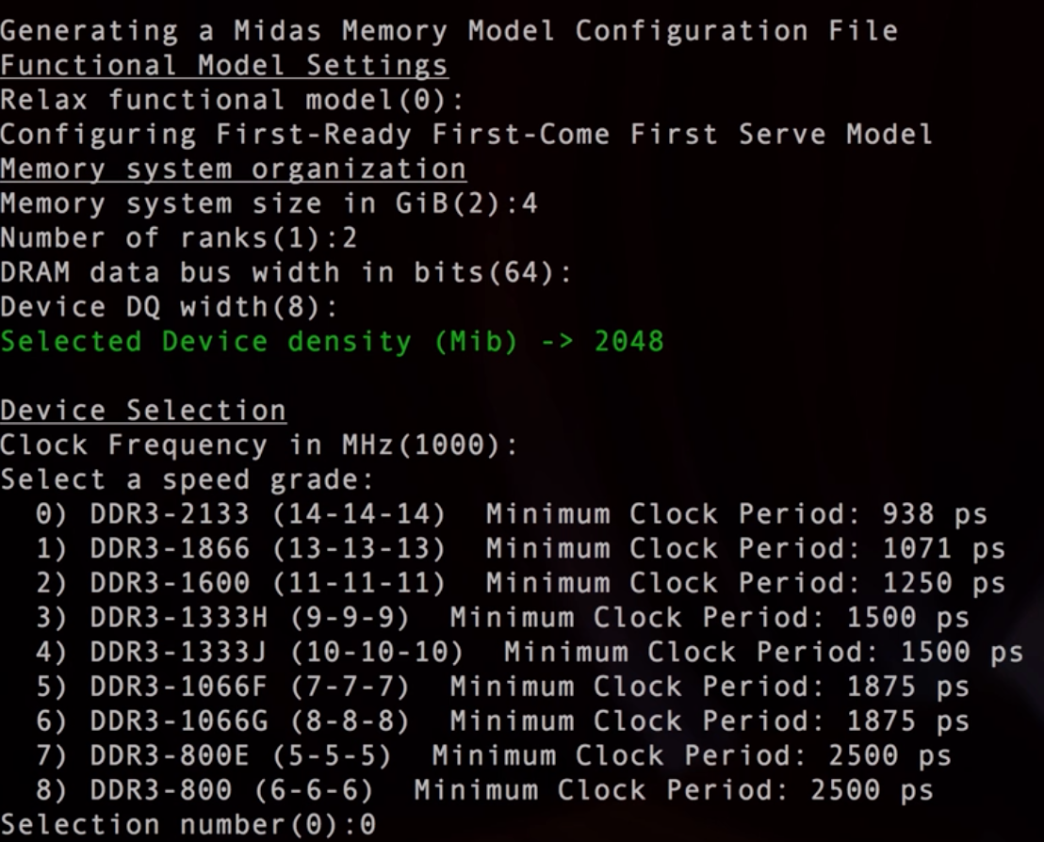

Slide 28
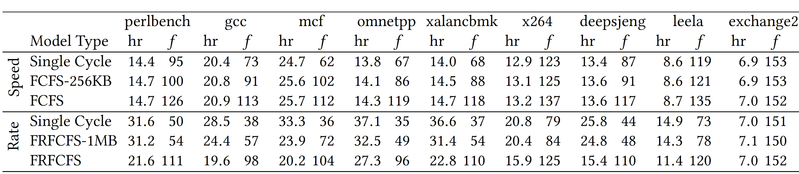
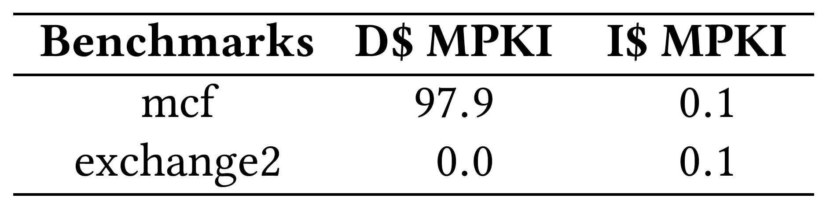
Simulator Performance
FASED instances are fast!
Can run at the FPGA host frequency
Only need to stall when when host-DRAM latency > desired target latency
From SPEC2017 intspeed w/ reference inputs, Rocket, RV64GC, 16 KiB L1 I & D$
V9UP, 160 MHz host frequency

Slide 29
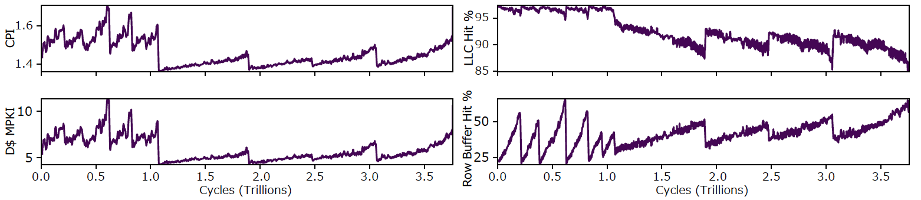
Non-Invasive Instrumentation
Timing models expose rich instrumentation ports
Automatically bound to memory map
Can be polled without perturbing simulation behavior
SPEC2017 Intspeed - Leela. Single-core Rocket. FASED: DDR3-2133 QR, FCFS + 256 KiB LLC

Slide 30
Conclusion
FASED fills an important hole in how we model memory systems in FPGA-accelerated simulators.
Instances are fast (>100 MHz)
Detailed, comparable to DRAMSim2
Highly reconfigurable
Check out FireSim as a platform for evaluating your next custom-hardware / accelerator project.
Notes:
1m

Slide 31
Questions?
FireSim’s GitHub: https://github.com/firesim/firesim
FireSim’s Webpage: https://fires.im/
FireSim’s Doc: https://docs.fires.im/
Acknowledgements:
The information, data, or work presented herein was funded in part by the Advanced Research Projects Agency-Energy (ARPA-E), U.S. Department of Energy, under Award Number DE-AR0000849. Research was partially funded by ADEPT Lab industrial sponsor Intel, and ADEPT Lab affiliates Google, Huawei, Siemens, SK Hynix, and Seagate. The views and opinions of authors expressed herein do not necessarily state or reflect those of the United States Government or any agency thereof.

